Slide 1

Education
CUDAP Sign Choir
CUDAP@cornell.edu

Slide 2

Vocab List!
College
Class
Exam/Test
Graduate
School
Deaf School
Homework
Teacher
Learn / Student
Lecture
Study
All-night / All-nighter
Library

Slide 3
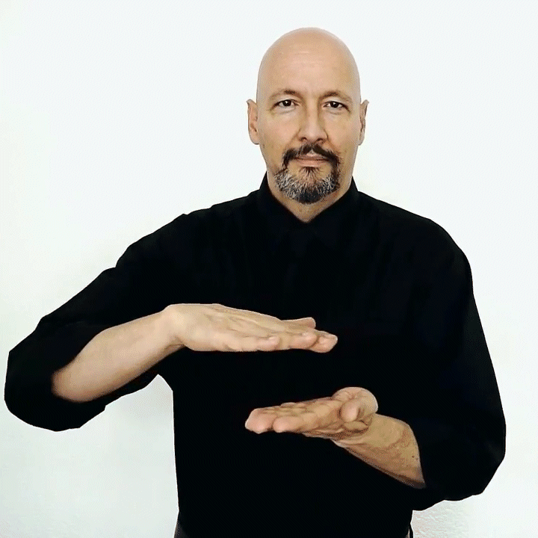
College
DESCRIPTION: Use 2 flat hands; tap right on left and make a circle

Slide 4
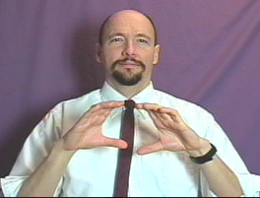
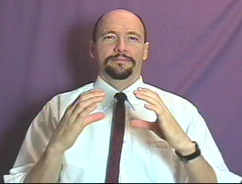
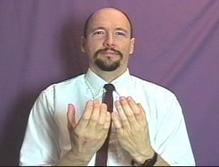
Class
DESCRIPTION: Start with 2 C hands in front of chest, thumbs and index fingers touching. Move outwards in a circle so pinkies are touching

Slide 5
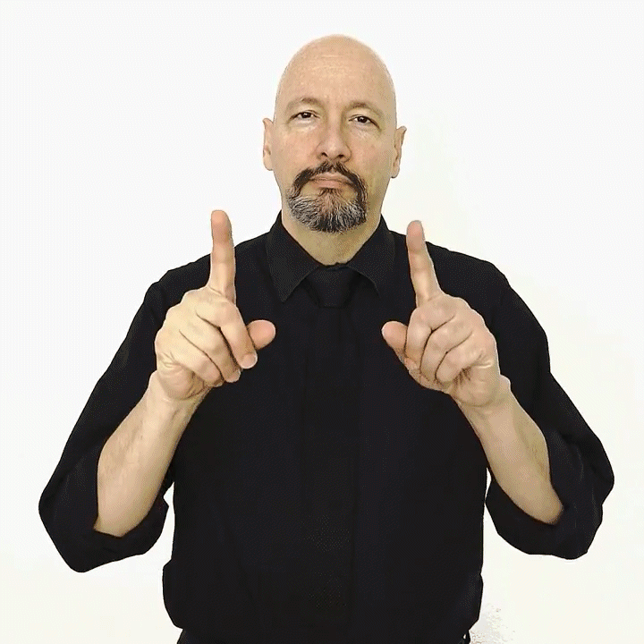

Exam/Test
DESCRIPTION: Start with 2 1-hands, curve into x-hands while moving downward (like drawing a question mark). Flatten into 5-hands.

Slide 6
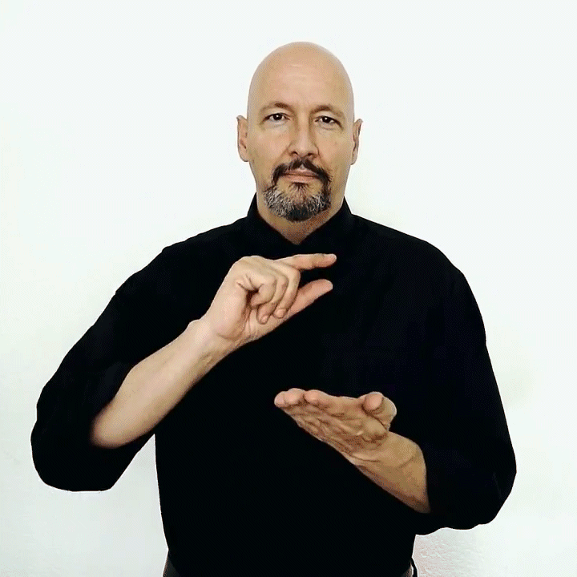
Graduate (verb)
DESCRIPTION: Make a small circle with a right G hand and tap against flat left hand

Slide 7
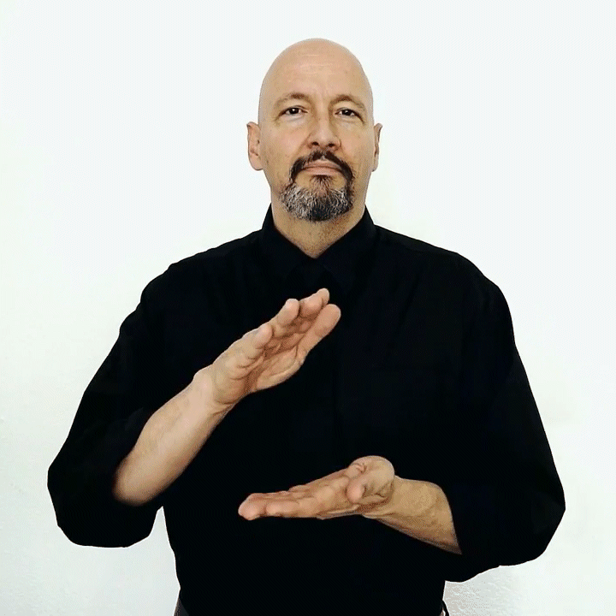
School
DESCRIPTION: Clap two flat hands together twice

Slide 8
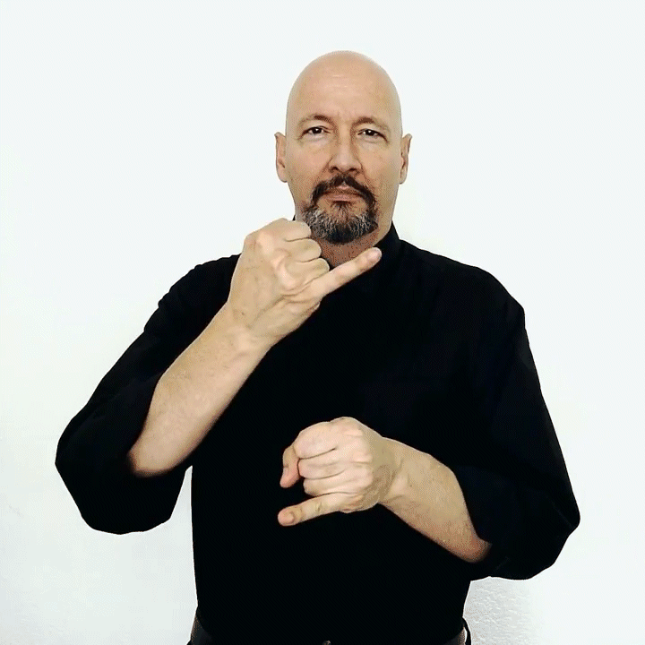
Residential School / Deaf School
DESCRIPTION: Tap two I hands together, right on top
A “Deaf School” is usually understood to mean a state-run, residential school. These are similar to prestigious boarding schools or prep schools, so most graduates of Deaf schools are proud to have attended.

Slide 9
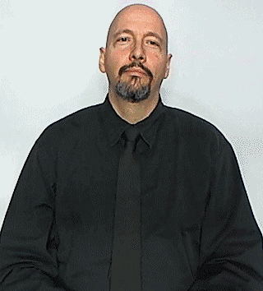

Homework
DESCRIPTION: Compound sign combining “Home” and “Work.” Touch cheek with flattened O hand, then tap fists together.

Slide 10
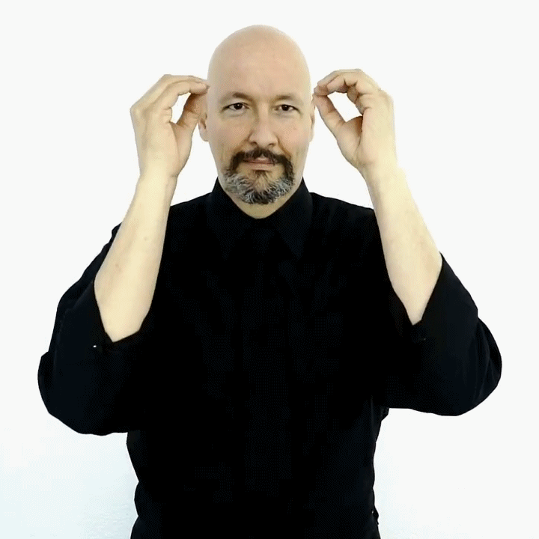
Teacher
DESCRIPTION: Move O hands from your head out, then change to flat hands and move down

Slide 11
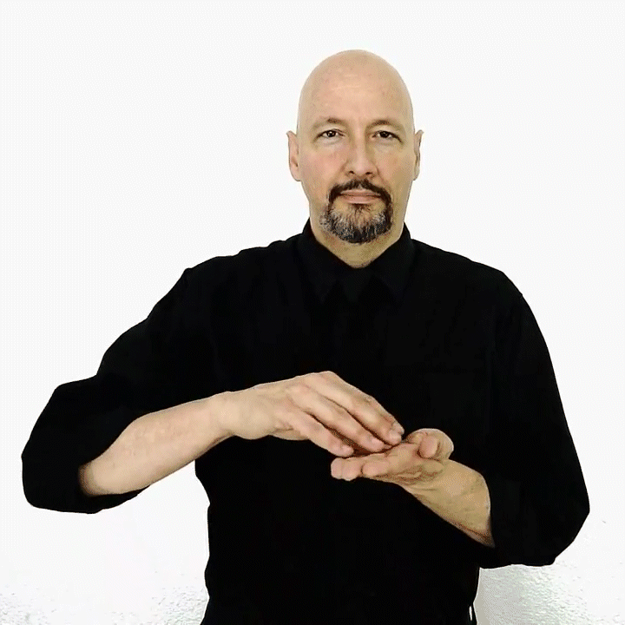
Learn
DESCRIPTION: Imagine picking up information from a page and putting it in your head. If you add the flat hands at the end like “Teacher,” you get “Student”

Slide 12
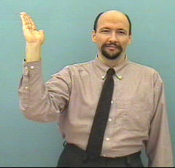
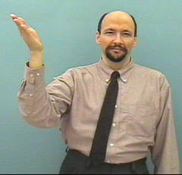
Lecture
DESCRIPTION: Hold up right flat hand and tilt inward twice

Slide 13
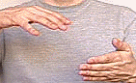

Study
DESCRIPTION: Wiggle right fingers over left Flat hand, movinng a little closer

Slide 14
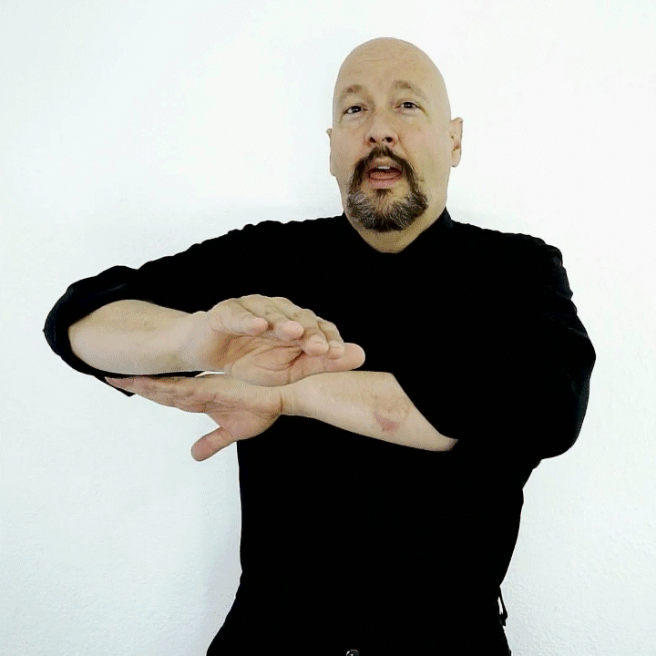
All-night
DESCRIPTION: Sweep right arm under left arm, like the sun moving below the horizon from dusk to dawn
“ALL-NIGHTER” = “STUDY” + “ALL-NIGHT”

Slide 15
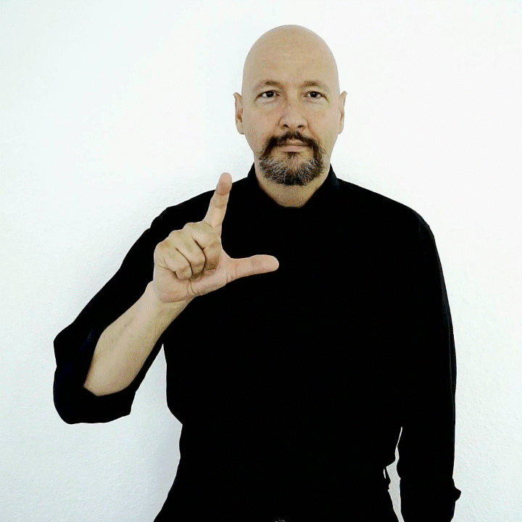
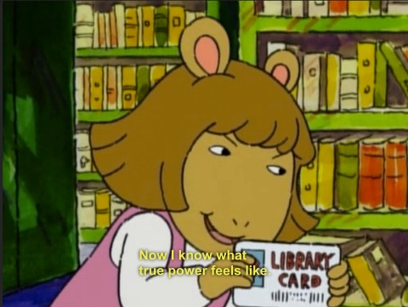
Library
DESCRIPTION: Move L hand in a clockwise circle (from your perspective)

Slide 16
Questions?

